Slide 1
Enhancing Enterprise Search with Machine Learning
By Simon Hughes, Dice.com

Slide 2
Who Am I?
Chief Data Scientist at DHI (Dice.com) under Yuri Bykov
Dice.com – leading US job board for IT professionals
PhD Candidate DePaul University (NLP and Machine Learning)
Twitter handle: https://twitter.com/hughes_meister
Email: simon.hughes@dice.com
Main Data Science Projects
Dice Job and Talent Search
Dice Recommender Engines (e.g. Similar Positions)
Dice Salary Predictor - https://www.dice.com/salary-calculator
Dice Career Paths Page - https://www.dice.com/career-paths
Dice Skills Pages - https://www.dice.com/skills

Slide 3
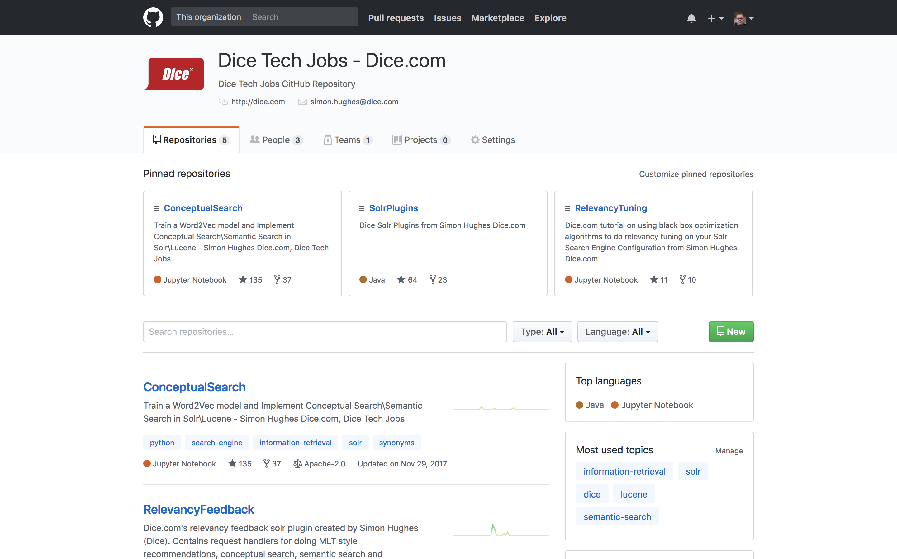
Salary Predictor
Notes:
Salary Predictor - https://www.dice.com/salary-calculator

Slide 4
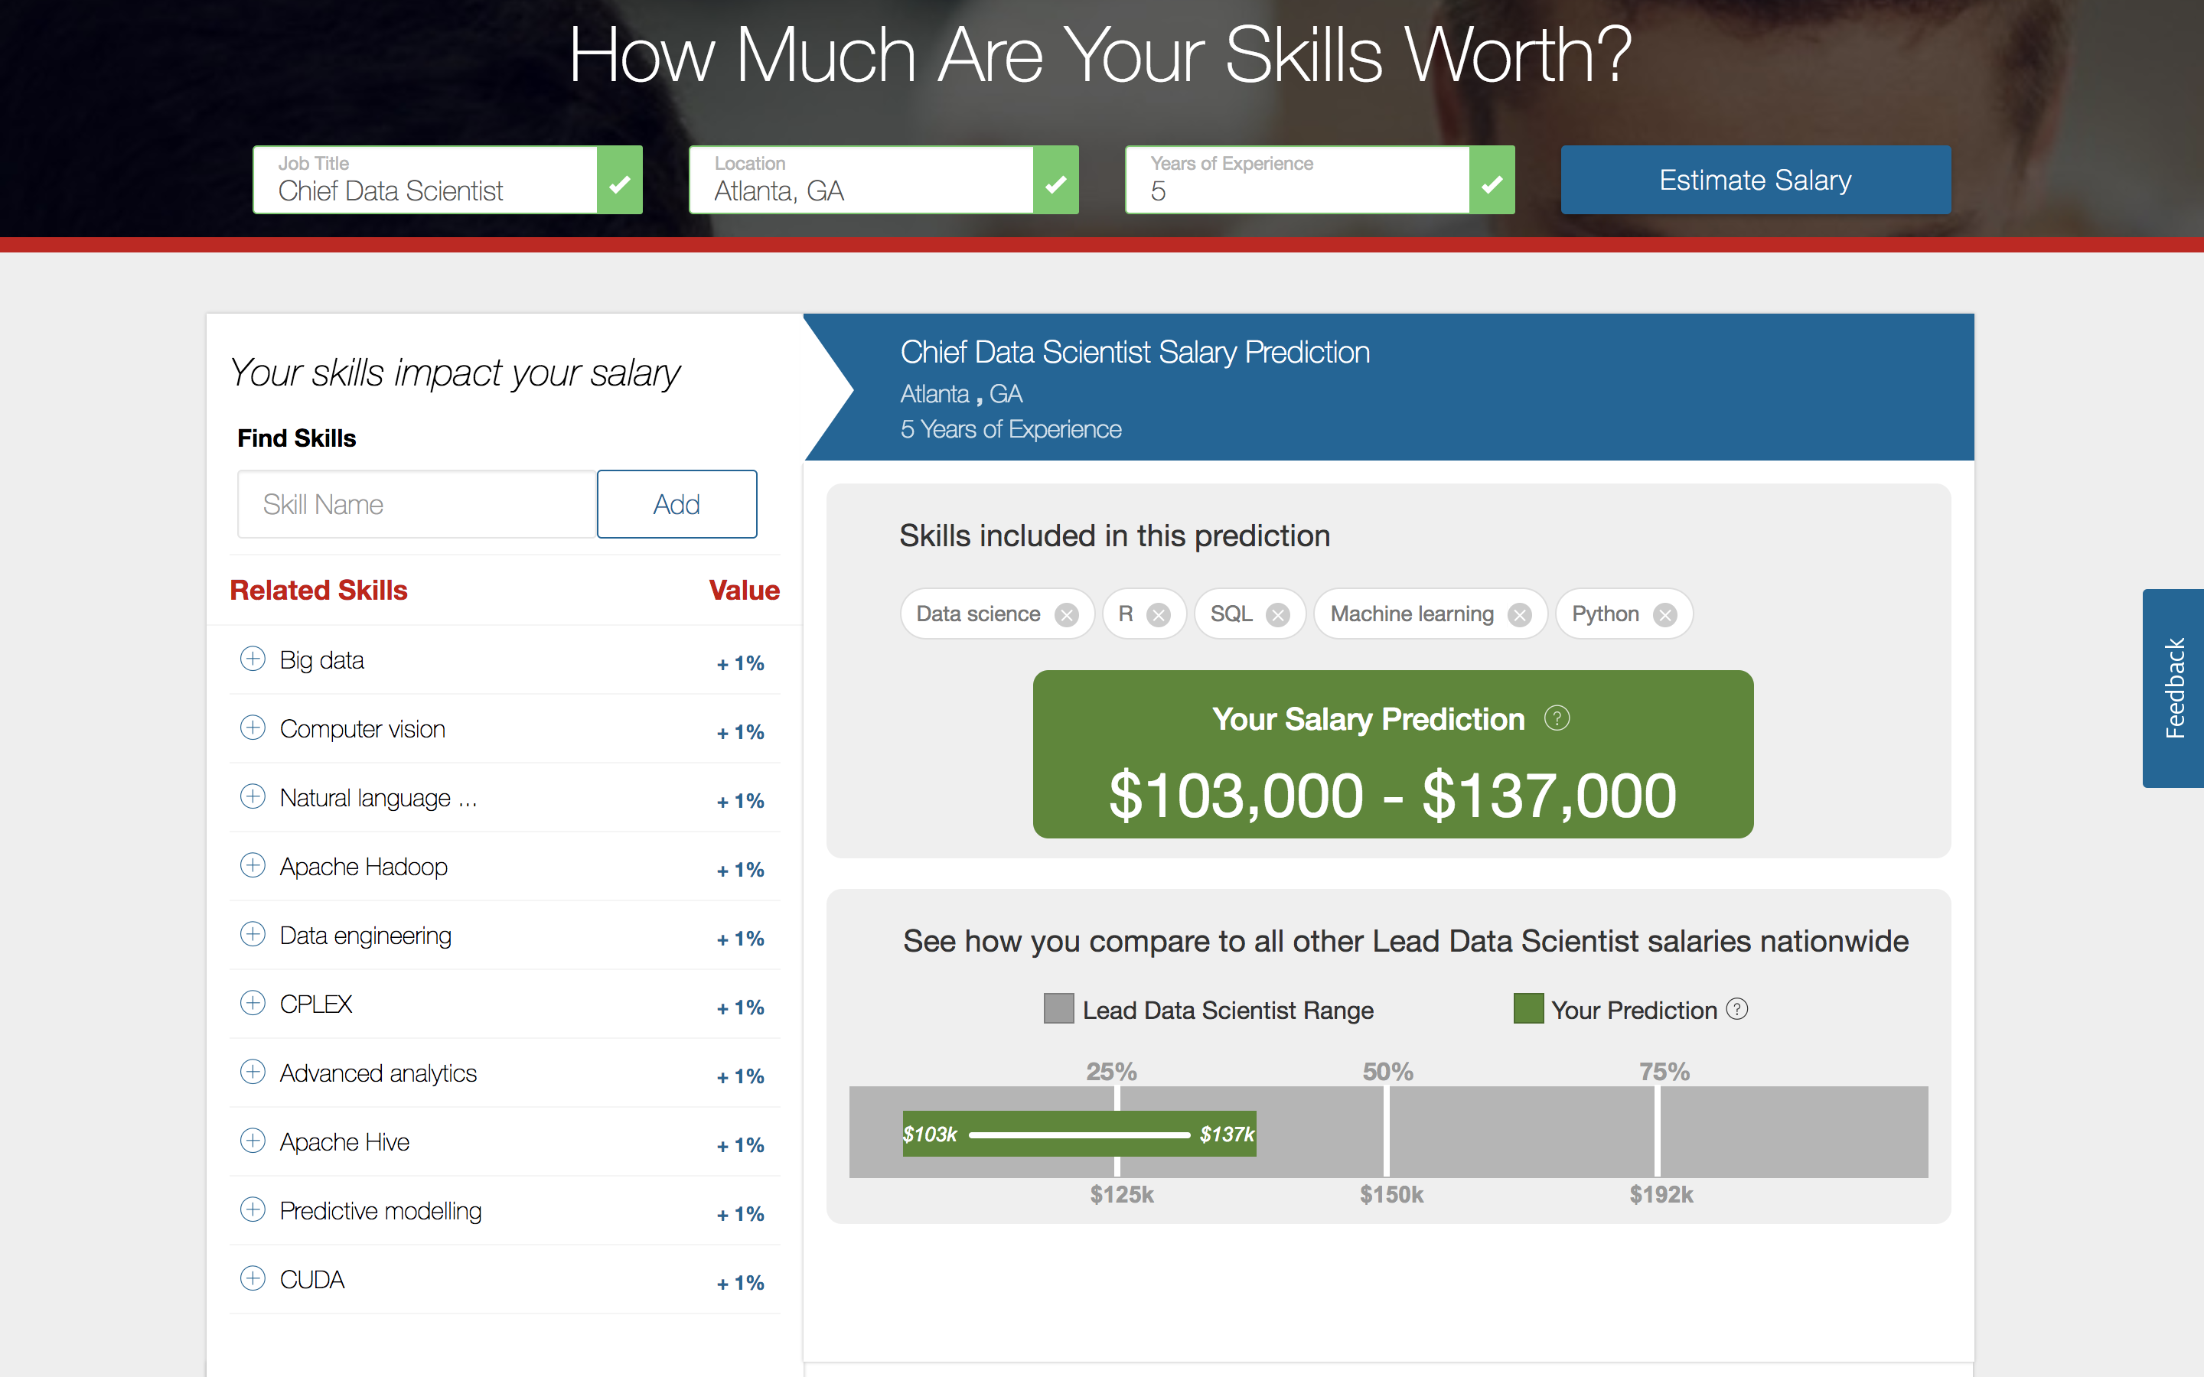
Salary Predictor
Notes:
Salary Predictor - https://www.dice.com/salary-calculator

Slide 5
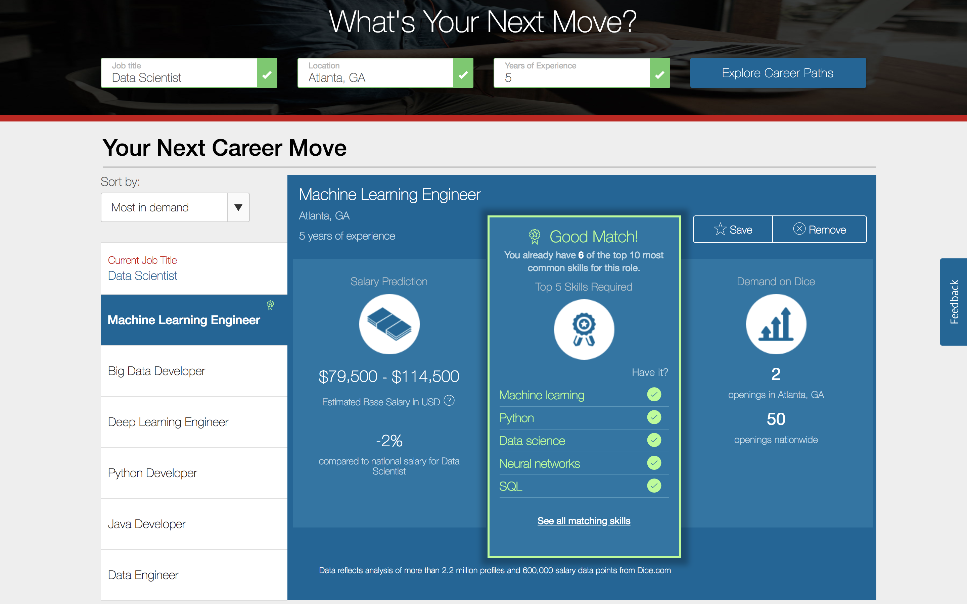
Notes:
Career Paths - https://www.dice.com/career-paths

Slide 6
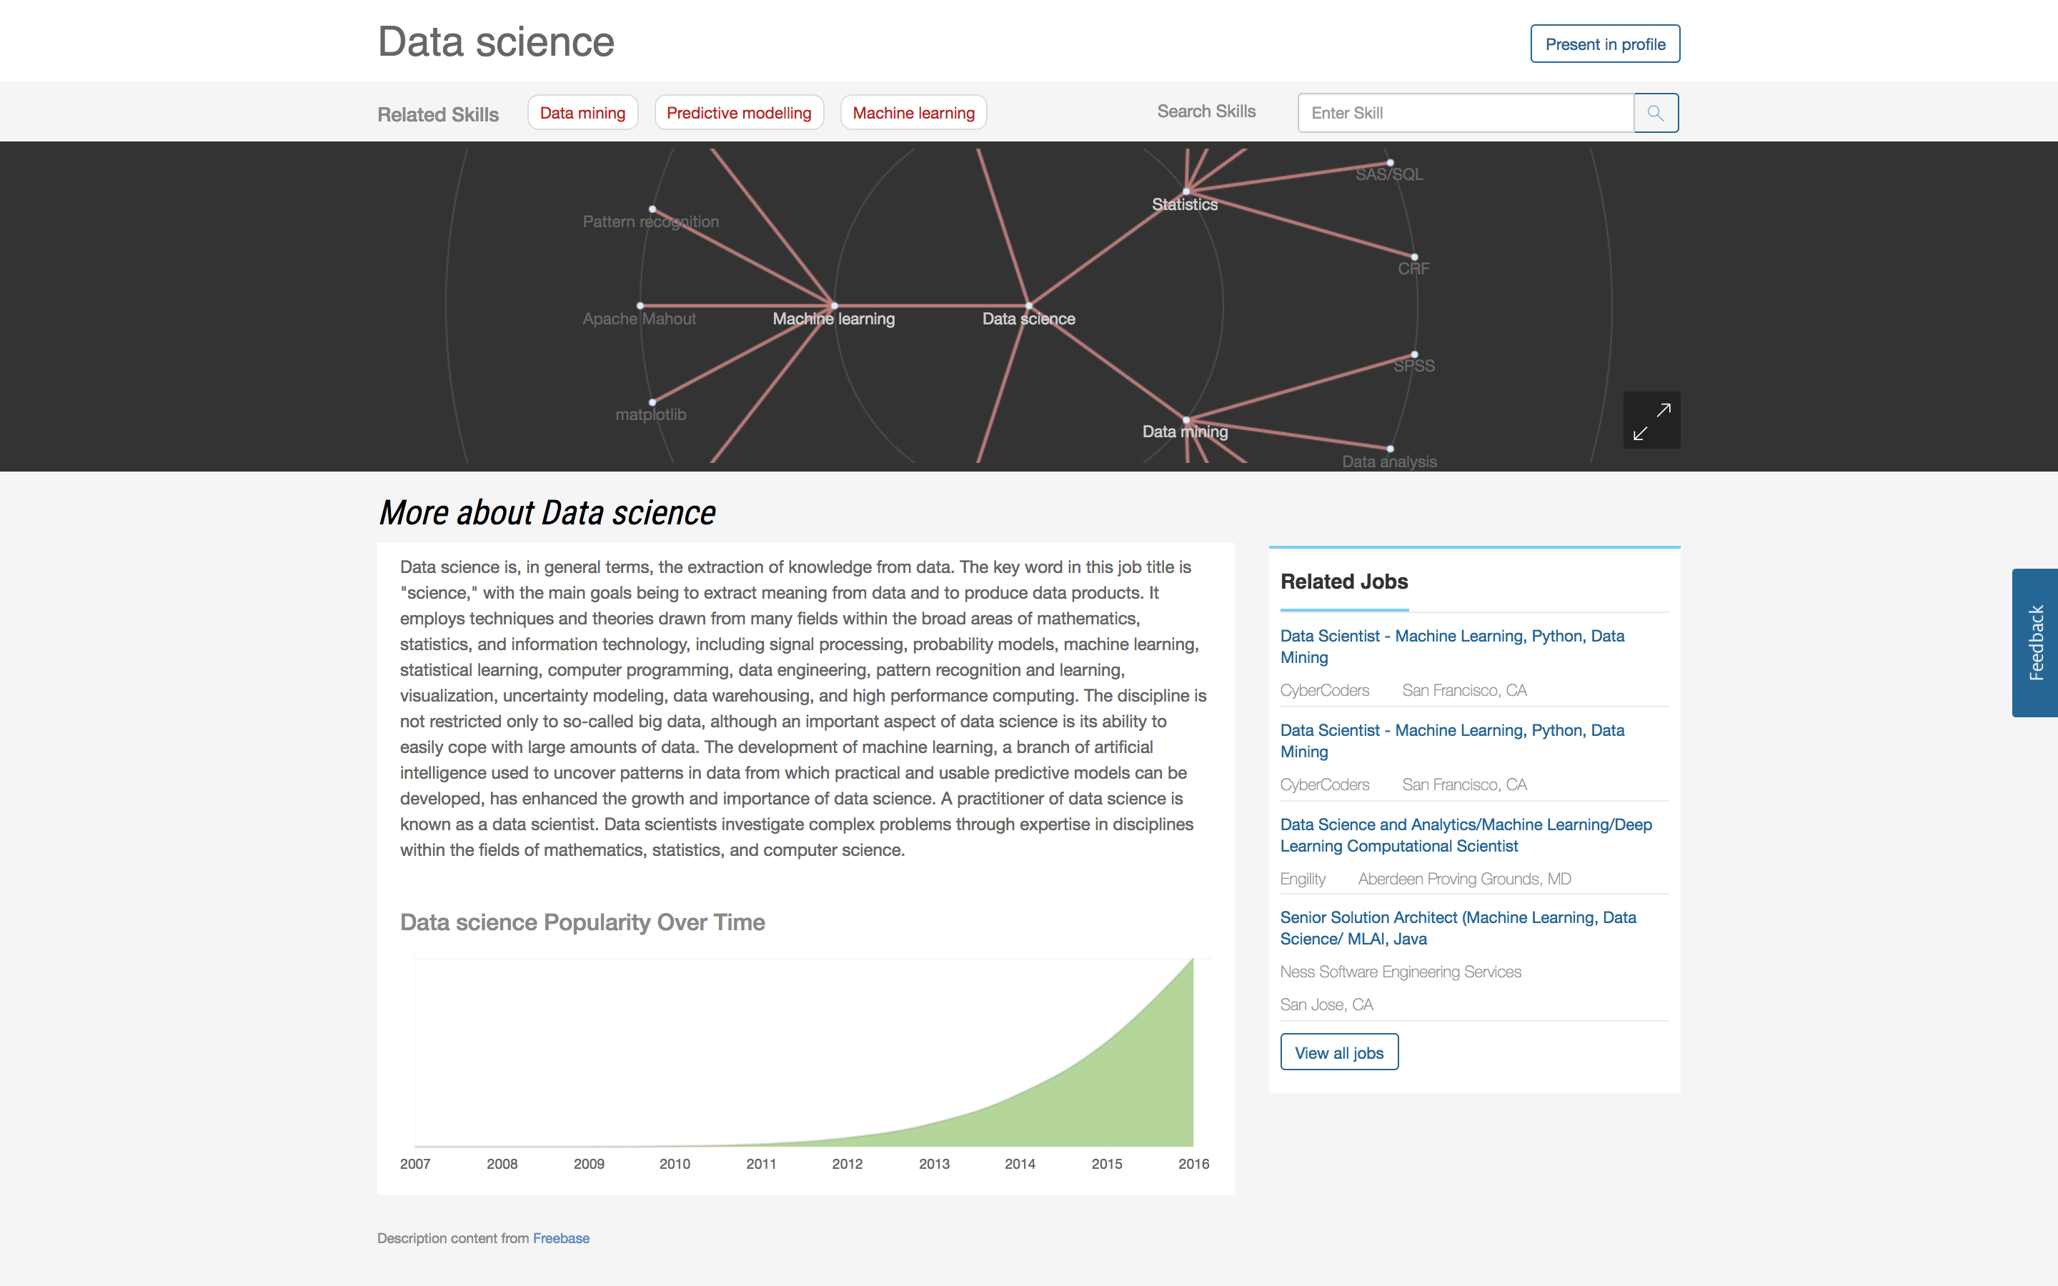
Notes:
Skills pages - https://www.dice.com/skills

Slide 7
Measuring Search Relevancy
Recall - How many of the relevant documents were returned?
Precision - How relevant were the results returned?
Recall
Relevant Documents
Retrieved Documents
Precision
Retrieved Relevant Documents

Slide 8
Relevancy Optimization
Improving Recall – Conceptual Search*, Blind Feedback
Improving Precision – Query Optimization*, Query Classification, LTR
Optimizing for precision is easier – correct mistakes in the current search results
Optimizing for recall is harder – need to know which relevant documents in the index don’t get retrieved
Notes:
This talk will cover conceptual search and query optimization techniques. Query classification and LTR (Learning To Rank) are other common approaches to improving precision which won’t be covered in this talk.

Slide 9
Conceptual Search
A.K.A. Semantic Search
Two key challenges with keyword matching:
Polysemy: Words have multiple meanings
E.g. engineer – mechanical engineer? Programmer? automation engineer?
Synonymy: Many different words have the same or similar meaning
E.g. QA, quality assurance, tester; VB, Visual Basic, VB.Net
Other related challenges –
Typos, Spelling Errors, Idioms
Conceptual search attempts to solve these problems by learning concepts from words
Attempts to improve recall

Slide 10
Conceptual Search
Java Technologies*
Senior Hadoop* Developer
At least eight years of database/application development experience in an complex enterprise environment. Experience writing in SQL, stored procedures, query performance tuning preferably on SQL Server. Strong familiarity with working in a Linux and Windows environment which includes shell and power shell scripting. At least two years of hands on experience designing and implementing data pipelines in production using tools from the Hadoop* ecosystem such as MapReduce, Hive, HBase, Spark*, Sqoop, Oozie, and Pig. Broad knowledge of software development including software architecture, functional and non-functional aspects, CI/CD, principles and tools
System Admin
Big Data
Software Architecture
Databases
*items are also java technologies
Notes:
Map words to concepts
Words can map to multiple concepts, e.g. the java technologies above, a number of terms map to that.

Slide 11
Conceptual Search
Conceptual search allows us to retrieve documents by how similar the concepts in the query are to the concepts in a document
Concepts are automatically learned from documents using machine learning
Traditional techniques (LSA, LDA) are based on factorizing large matrices and don’t scale well
Word2vec – learns vector representations of words based on context - an iterative algorithm, scales much better

Slide 12
Word2vec
Learns vector representations of words by predicting surrounding words
Similar words get similar vector representations
Finds interesting relationships between words - e.g. ‘word math’

Slide 13
Word2vec Pros and Cons
Works much better if common phrases are treated as single tokens
e.g. java developer=>java_developer, sql server=>sql_server
Advantages
Effective at learning related terms /phrases
e.g. java developer, j2ee developer, java engineer, java architect, hadoop engineer
Disadvantages
Doesn’t handle word sense disambiguation well
Sees antonyms as similar as appear in similar contexts:
Black and white, up and down, hot and cold, Trump and Clinton, Democrat and Republican
If the keywords in your domain are noun phrases, typically less of an issue
Often aggregating concepts over an entire document can solve a lot of these issues provided query is disambiguated

Slide 14
Using Word2vec In Search
Search engines use inverted indexes - work with terms and not vectors. Approaches:
Query Expansion
Expand user’s query with most similar word2vec terms/phrases
Doesn’t require modifying the search index
Can boost expansion terms using word2vec similarity score
Clustering
Cluster word2vec terms and create separate fields mapping terms into their clusters
Easy to implement using standard synonym files
Create different sized clusters to get broader / finer grain matching
Re-Ranker
Re-rank the top n documents of a query using the word2vec vector similarity
More complicated to implement
Can be used as features for a LTR model

Slide 15
Learned Clusters
Pre-processing - Colocation (phrase) detection using PMI, word2vec over phrases and top keywords, then k-means clustering
Natural Languages: bi lingual, bilingual, chinese, fluent, french, german, japanese, korean, lingual, localized, portuguese, russian, spanish, speak, speaker
Apply Programming Languages: cocoa, swift
Search Engine Technologies: apache solr, elasticsearch, lucene, lucene solr, search, search engines, search technologies, solr, solr lucene
Microsoft .Net Technologies: c# wcf, microsoft c#, microsoft.net, mvc web, wcf web services, web forms, webforms, windows forms, winforms, wpf wcf
Notes:
Labels in bold are manually assigned for interpretability

Slide 16
Learned Clusters – Soft Skills
Attention / Attitude:
attention, attentive, close attention, compromising, conscientious, conscious, customer oriented, customer service focus, customer service oriented, deliver results, delivering results, demonstrated commitment, dependability, dependable, detailed oriented, diligence, diligent, do attitude, ethic, excellent follow, extremely detail oriented, good attention, meticulous, meticulous attention, organized, orientated, outgoing, outstanding customer service, pay attention, personality, pleasant, positive attitude, professional appearance, professional attitude, professional demeanor, punctual, punctuality, self motivated, self motivation, superb, superior, thoroughness

Slide 17
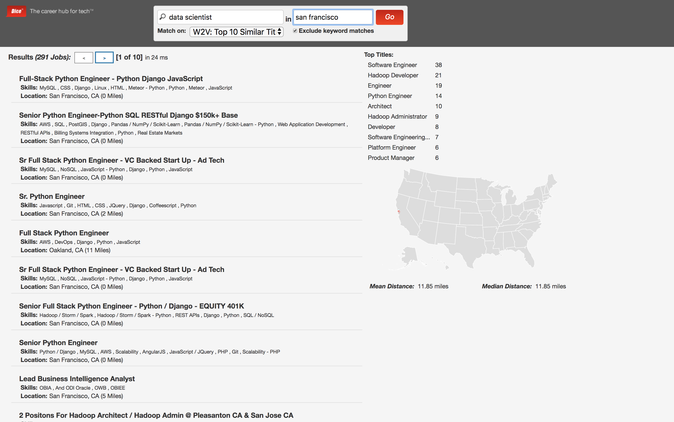
Conceptual Search In Action
Only conceptual search matches shown – all keyword matches are excluded
These are documents that would not be returned by regular keyword search

Slide 18
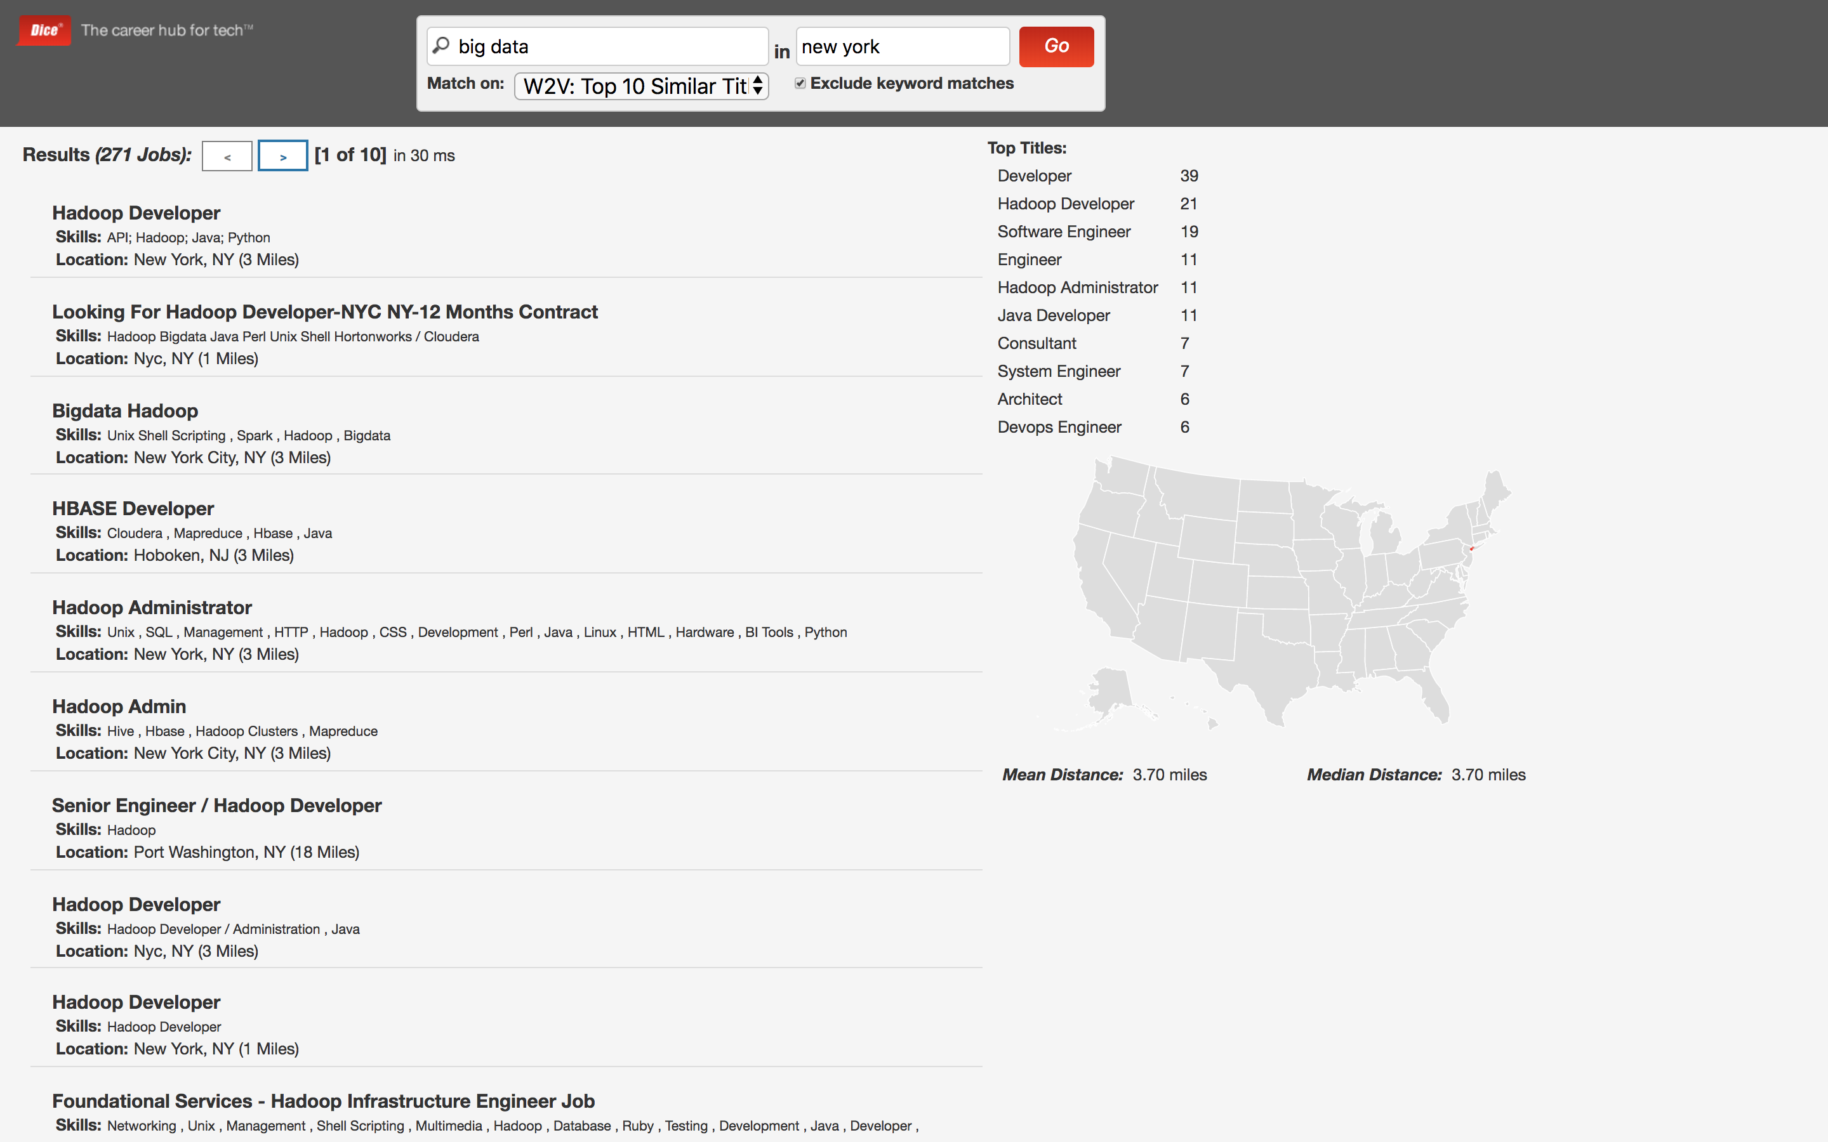
Conceptual Search In Action
Only conceptual search matches shown – all keyword matches are excluded
These are documents that would not be returned by regular keyword search

Slide 19
Relevancy Tuning
Search engines provide a lot of different knobs that can be used to improve relevancy
These include the weight (or ‘boost’) given to each field in a search query, the minimum number of terms required for a match, what type of queries are executed (disjunction max, best fields, etc), and document quality scores (e.g. google’s page rank)
Often these knobs are tuned manually by the search engineer to optimize their view of the optimal search experience
Focus is primarily on precision as easier to judge
Can we do better?

Slide 20
Golden Test Collection
We really need a set of high quality relevancy judgements
Two Main Sources:
Manual Annotations
Expert users rate results for common queries
Costly to collect
May not reflect judgements of your users
Active learning can be used to improve annotation efficiency if used in LTR
Search Logs / Click Stream Data
Collect data from search logs that indicate which documents seem to be relevant
Reflects how your users view relevancy
Relies on implicit signals which can be noisy – documents clicked, viewed
Hard to get explicit feedback from users

Slide 21
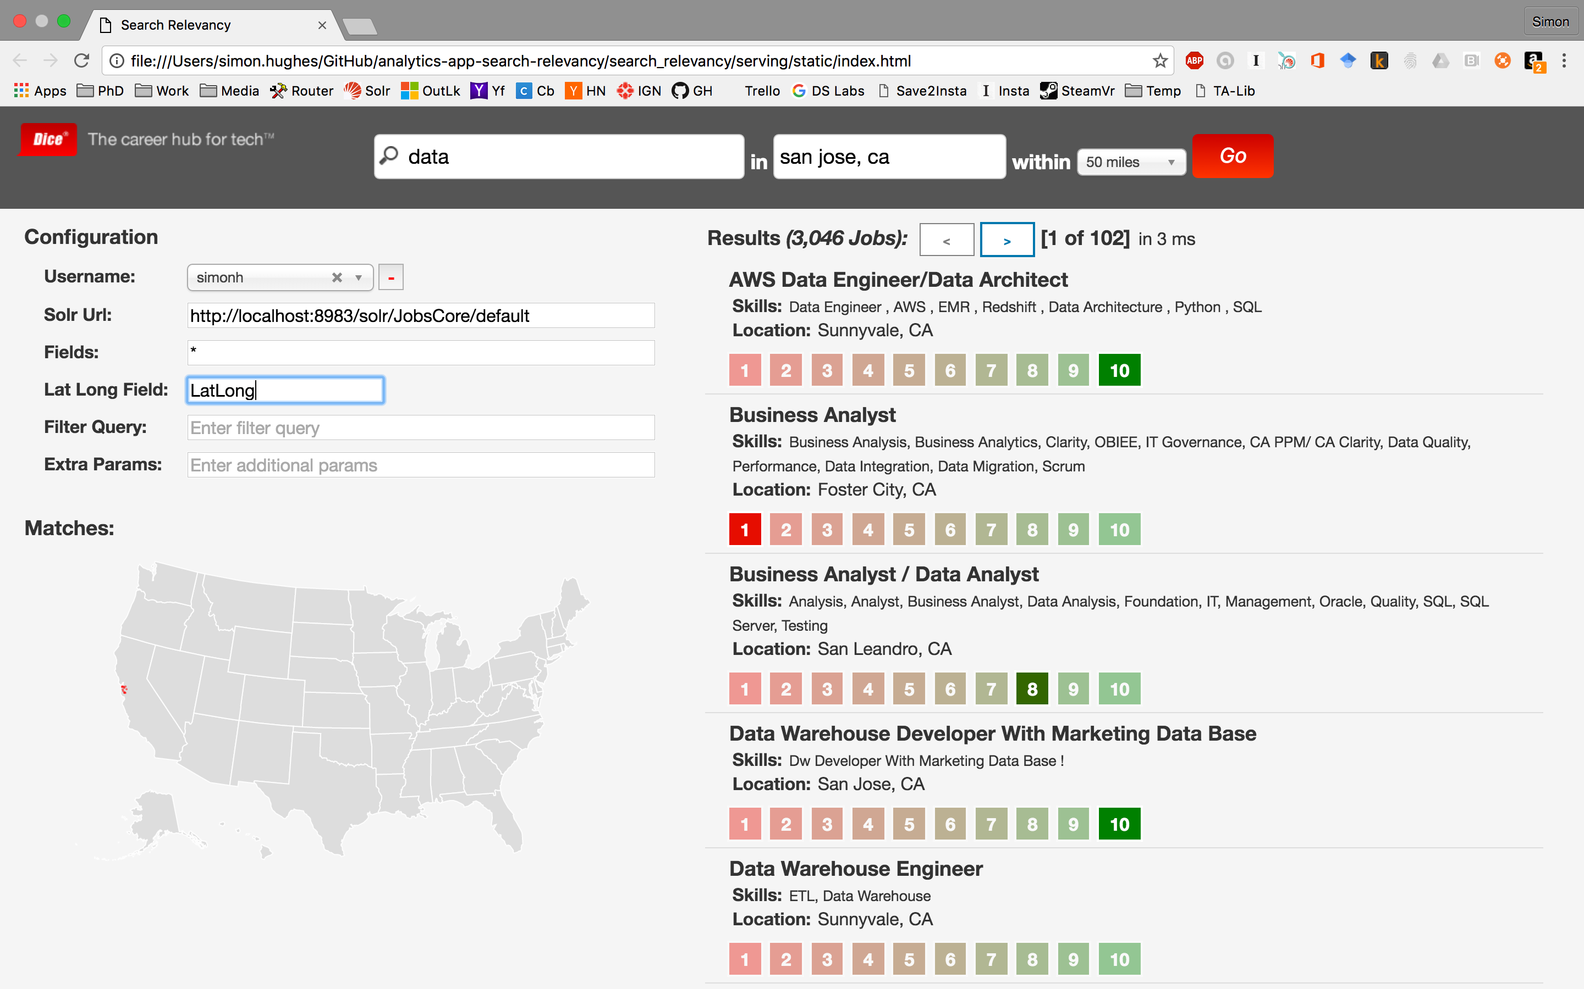
Manual Annotations
Users rate each document based on how relevant it is to the query
Important that the ratings differ for a query, otherwise no useful information is provided to the algorithm

Slide 22
Machine Learning Approaches
Often we can’t optimize search engine relevancy directly as the scoring functions are not differentiable
Evaluating relevancy can be very costly – running thousands of queries against the search engine to evaluate each parameter configuration
Instead we can use black-box optimization algorithms to optimize the parameters, typically this is more efficient than random search
Most companies also using machine learning to train a re-ranking model to re-rank the top N results
However it is better to first optimize the search engine’s settings so that the top N results are more likely to contain the most relevant documents

Slide 23
Information Retrieval Metrics
Precision alone is not a great metric as it is insensitive to the ordering of the documents returned
Objective – maximize preferred information retrieval metric:
Normalized Discounted Cumulative Gain (NDCG)
Discounts relevancy scores by their ranking in the results
Mean Average Precision (MAP)
Average of the precision at the location of each relevant document returned
Precision at k
Precision at the top k documents (usually 10)
Insensitive to the ordering of documents within top k
NDCG is used when you have ratings, MAP and ‘Precision at k’ are used for binary relevant/irrelevant judgements or click data

Slide 24
Black Box Optimization Algorithms
Genetic Algorithms
Standard GA
Evolutionary Strategies
Genetic Programming – for evolving new scoring equations
E.g Python DEAP package
Bayesian Optimization
As it searches the parameter space, focuses more on areas of uncertainty (using LCB and similar variants from reinforcement learning)
E.g. Python scikit-optimize package
Coordinate Ascent/Descent
Very simple algorithm – use a line search to find the optimal value for each parameter while keeping all others fixed
Can get stuck in local maxima/minima
Searches more efficiently than more random approaches
Notes:
DEAP – https://github.com/DEAP/deap
Scikit-optimize - https://scikit-optimize.github.io/

Slide 25
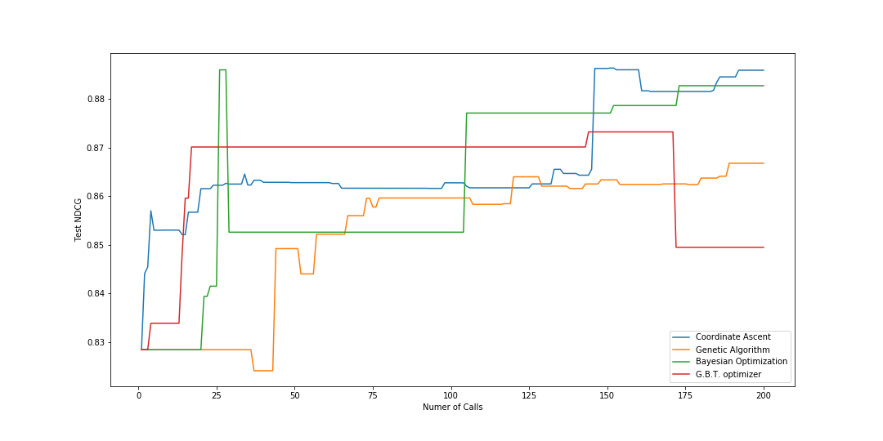
Test NDCG Improvements on MLT Task
Tried different algorithms for optimizing Elastic Search MoreLikeThis queries
Parameters – relative boosts on title and skills, number of terms extracted, min doc freq per term
Coordinate ascent produced the largest improvement in the training and test data
8.2% Improvement on test data set

Slide 26
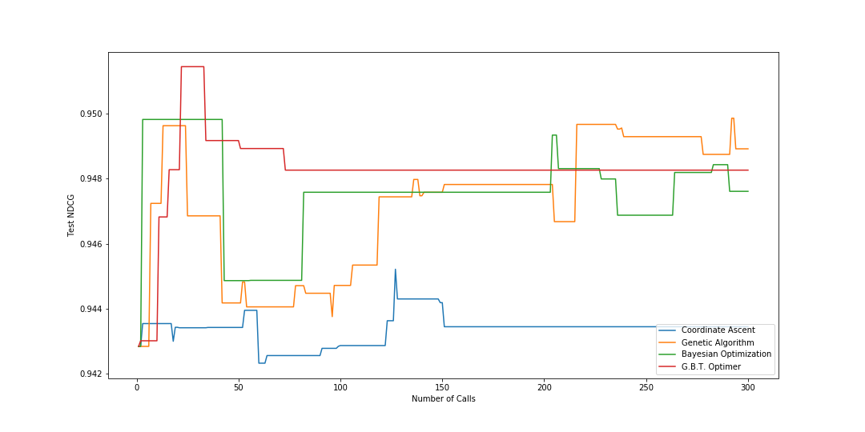
Test NDCG Improvements on Talent Search
Tried different algorithms for optimizing Talent search queries
Parameters – relative boosts on different fields, phrase vs term matching
GA produced the highest test score at the end, but GBT had highest test score overall – early stopping?
0.64% Improvement on test data set – much smaller but ratings quality much lower

Slide 27
Summary
There are many ways you can apply machine learning to improve your user’s search experience
I have gone over two ways in which you can improve the recall and relevancy of your search engine
Using conceptual search to learn synonyms and improve recall
Using black box optimization algorithms to automate relevancy tuning
Many other approaches for applying machine learning to improve search:
Learning to Rank (LTR)
Query Classification
Query Parsing
Personalization

